Slide 2





CANDIDATE PROFILE
NAME – Anurag Srivastava
EMAIL ID – anuanurag2410@gmail.com
CONTACT NUMBER - 7081328141

Slide 3

TOP 3 FEATURES OF K10 APP
Visualization
Personalization
Assessments

Slide 4
NEED IDENTIFICATION | AREA OF CONCERN OF THE PARENT
SCENARIO
I teach my child on my own and there are times when even i don’t have answers to his questions. He is an intelligent kid and generally asks a lot of questions . Unfortunately at this time with the limited resources i have i am not able to always give him the answer .
Answer : It is quite normal if you don’t have an answer to his/her question. Because in our times the quality of education was not the same as it is today. In this era of technology and competition child need a conceptual understanding of the topic to stand out in the crowd.
We have a doubt session for your child if he wants to ask any question just contact the mentor and a schedule is given, teachers are highly qualified so your child gets an answer of every question in his mind and get conceptual learning of the concept.

Slide 5
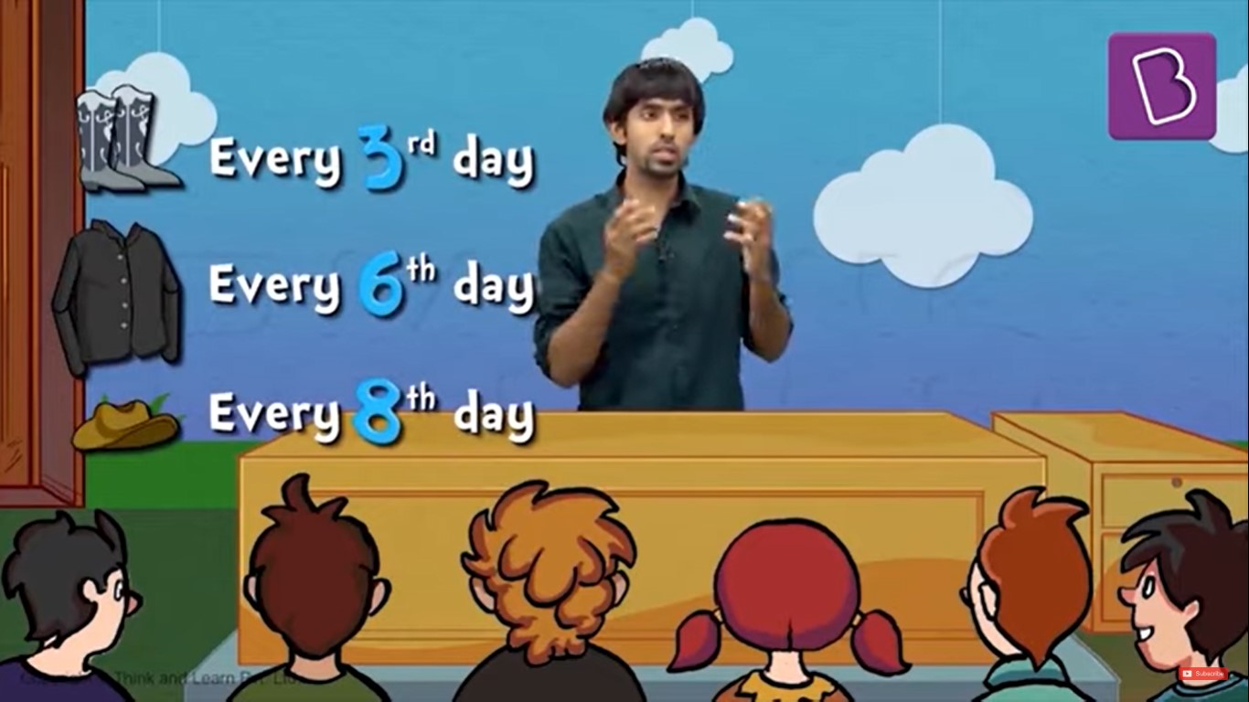
PRODUCT ILLUSTRATION |NEED-FEATURE MAPPING
PLEASE USE THIS PRODUCT VIDEO TO MAKE THE CUSTOMER REALISE THAT THIS FEATURE OF THE PRODUCT WILL TAKE CARE OF HIS/HER CONCERN
You have seen in the video that, how LCM is been taught through real-life examples.
That makes the child understand where is the application of the concept is and gives the child the answer of how and why.

